Slide 1
IMPACT OF COVID'19 ON MENTAL HEALTH
Presented By:
Joy Bhowmick – C22012
Tamosa Sur – C22027
Under the Guidance of:
Dr Sayantani Roy Choudhury
“What mental health needs is more sunlight, more candor, and more unashamed conversation.”
-Glenn Close

Slide 2
Index
Introduction
Data collection and methodology
Analysis
Conclusions and recommendations

Slide 3
Introduction
The COVID-19 pandemic presented as a black swan event. As a measure to curtail it the governments of different countries took various approaches. Most countries announced complete lockdowns, with draconian travel and social restrictions.
On March 24, 2020, the Government of India ordered a nationwide lockdown for 21 days, limiting the movement of the entire population to 1.3 billion. However, the days of lockdown kept on increasing and since then we have witnessed two dreadful lockdowns in the years 2020 and 2021.
Though this was probably a requisite, lockdowns, quarantine, and social distancing can precede long-term effects such as symptoms of mental stress and disorder, including insomnia, anxiety, depression, and post-traumatic stress symptoms.

Slide 4
Introduction (Contd.)
Although there is a deluge of studies published regarding COVID-19, there is a paucity of studies regarding the mental health status of the general population. Therefore, the present survey is intended to assess the mental health impact of the lockdowns on a convenient population.
After reviewing and validating the questions from Solanky Paul, pursuing Masters in Psychology, Delhi University, we have curated 46 questions in English, exploring age and job sectors, stressors which included fear of infection, helplessness, depressing thoughts, scarce supplies, stressors related to work, student life, finances, and stigma.
The study population consisted of 64 participants (out of the 100 invited) of which 3.2% were below 20 years, 68.75% were between 20−40 years, 17.2% were between 40-60 years and 9.3 % were over 60 years of age.

Slide 5
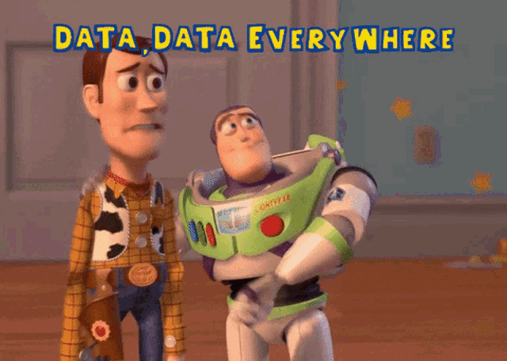
Data Collection And Methodology
Data Collection is the process of finding and loading the data into our system. Broadly there are three ways in which we can find data.
Private Data
Public Data
Self - conducted survey/research

Slide 6
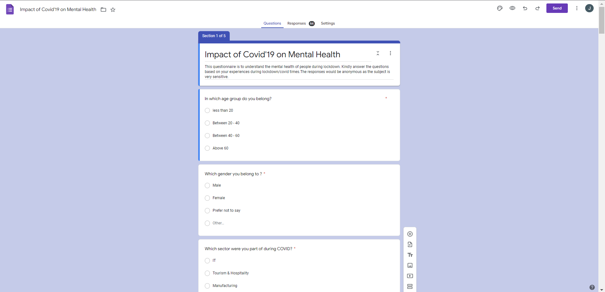
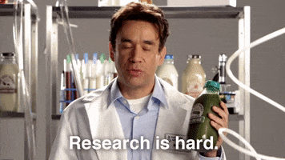
Questionnaire
Link:
https://forms.gle/HhTSSWUfdigSGWmZ6

Slide 7
Data Collection And Methodology(Contd.)
Private Data :
As the name suggests, private data is given by private organizations. There are some security and privacy concerns attached to it. This type of data is used for mainly the organization's internal analysis.
Public Data :
This type of Data is available to everyone. We can find this on government websites and public organizations etc. Anyone can access this data, we do not need any special permissions or approval.
Self-conducted survey/research :
It is the type of data collection that has been conducted here. A questionnaire has been formed as per the subject and convenience sampling was been performed.
A convenience sample is a type of non-probability sampling method where the sample is taken from a group of people easy to contact or reach.

Slide 8
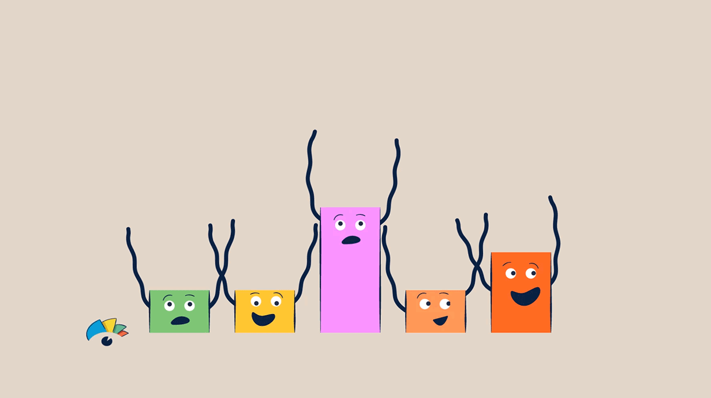
Analysis of our data using Tableau for general understanding of our respondents

Slide 9
Details of the respondents
The study population consisted of 64 participants (out of the 100 invited) of which 3.2% were below 20 years, 68.75% were between 20−40 years, 17.2% were between 40-60 years and 9.3 % were over 60 years of age.
The majority of our study population comprises of IT sector which is 32.7 %, followed by manufacturing and student sector which is 16.36%. Construction sector has 10.91% and educational( by profession) has 3.64%. The rest which is Automobile, Thermal Power, Oil and Gas and such other has 1.82% of the total study population.

Slide 10
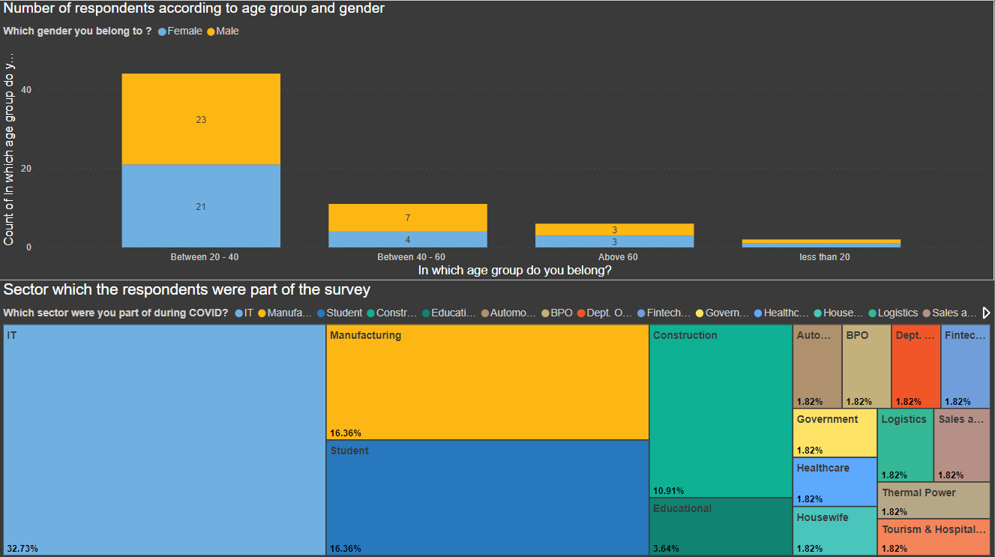
Details of the respondents
From our survey through questionnaire, we got respondents as follows:

Slide 11
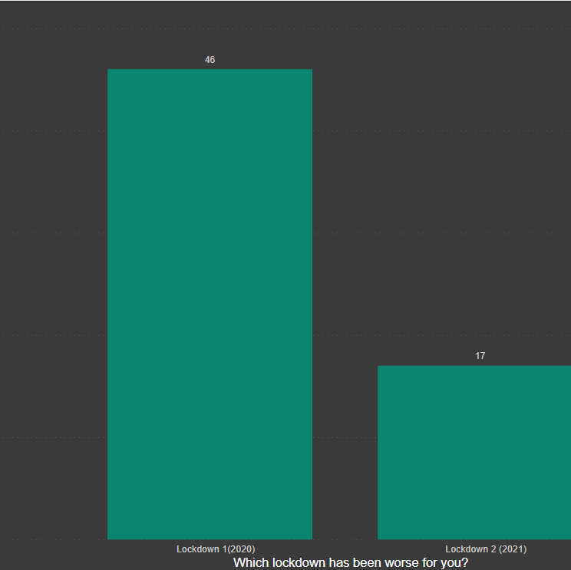
Lockdown which created the maximum impact
Out of 63 respondents we can observed from the graph that maximum of the respondents finds Lockdown of 2020 to be worse than 2021.

Slide 12
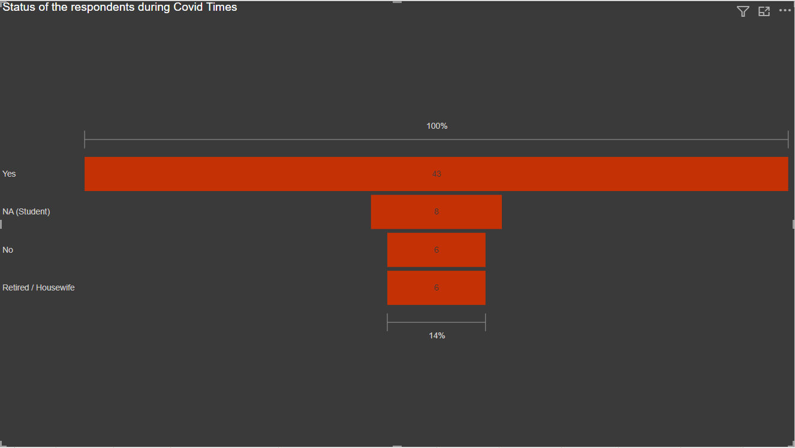
Status of the respondents during covid
68.2% of the sample population were employed during the times of Covid and 9.5% people were either unemployed or retired/housewife and 12.7% were students.

Slide 13
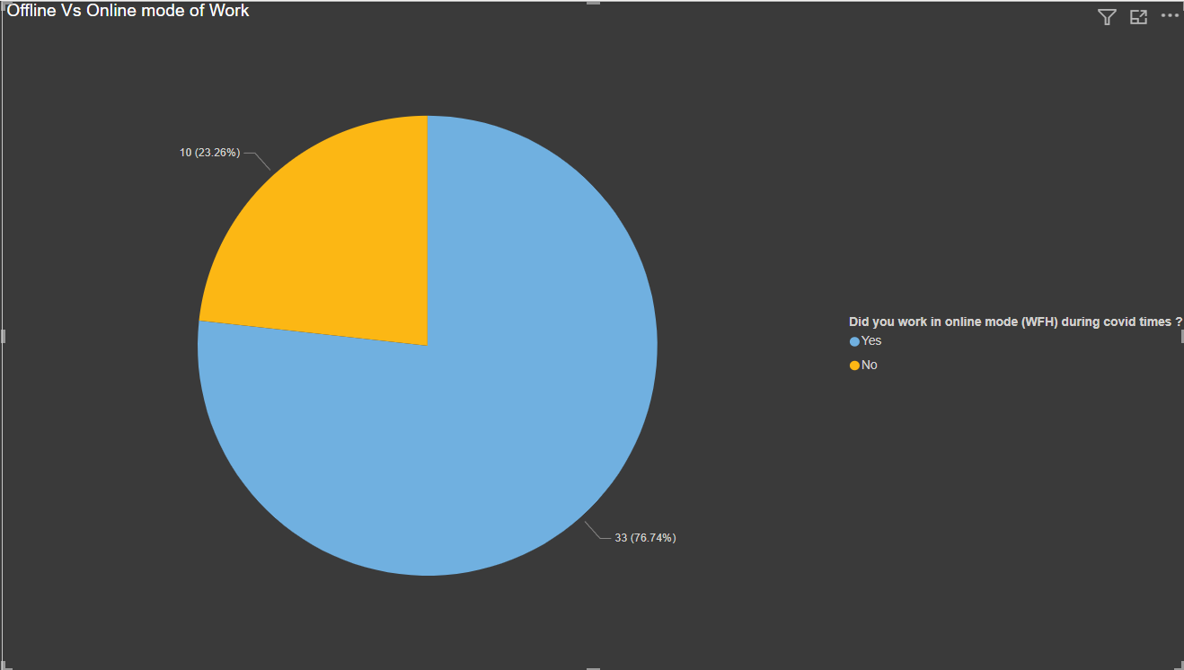
Online Vs Offline mode of work
The Online population is of 76.74% and offline population is of 23.26%

Slide 14
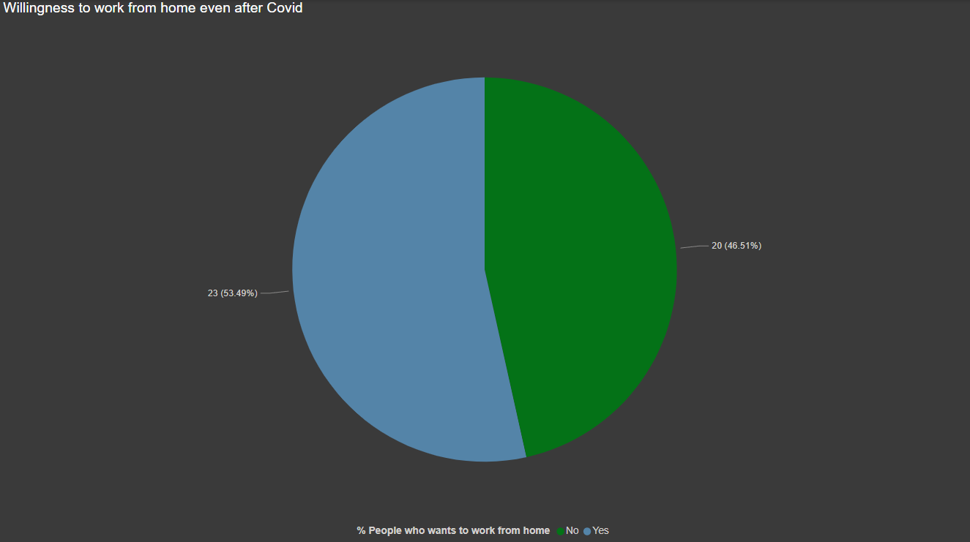
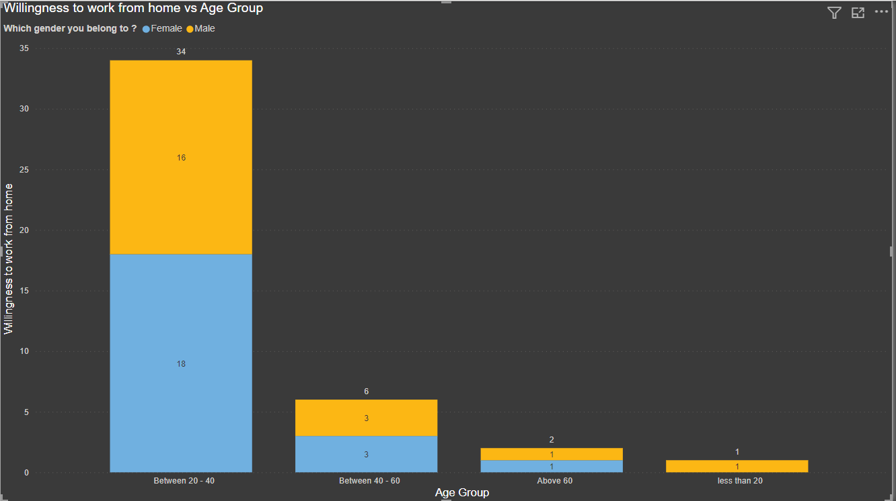
Willingness to work from Home even after Covid
From the graphs we can infer that 53.49% wants to work from home and depending on age group between 20-40 years of age people are more interested out of which females are more.

Slide 15
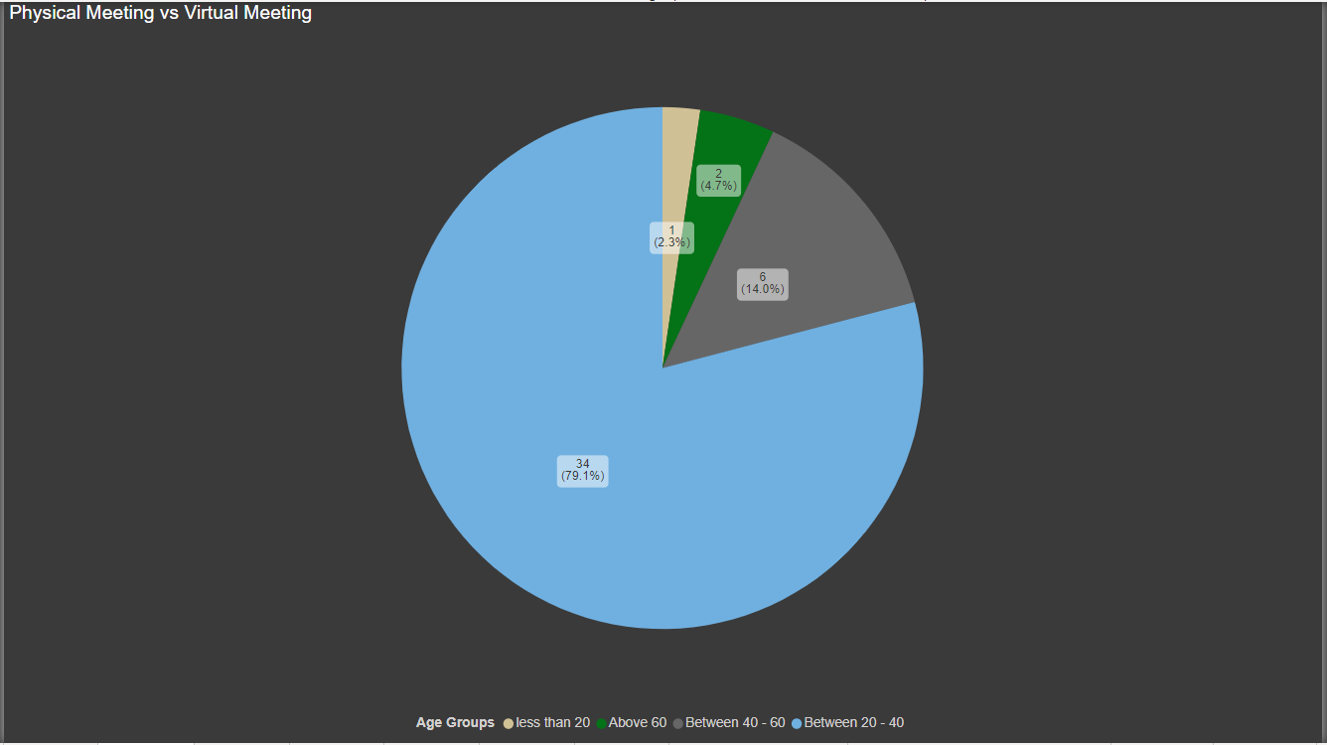
Physical meeting vs virtual meeting based on age group
Between the age group of 20-40 79.1% of the people opt for virtual meetings instead of physical interaction.

Slide 16
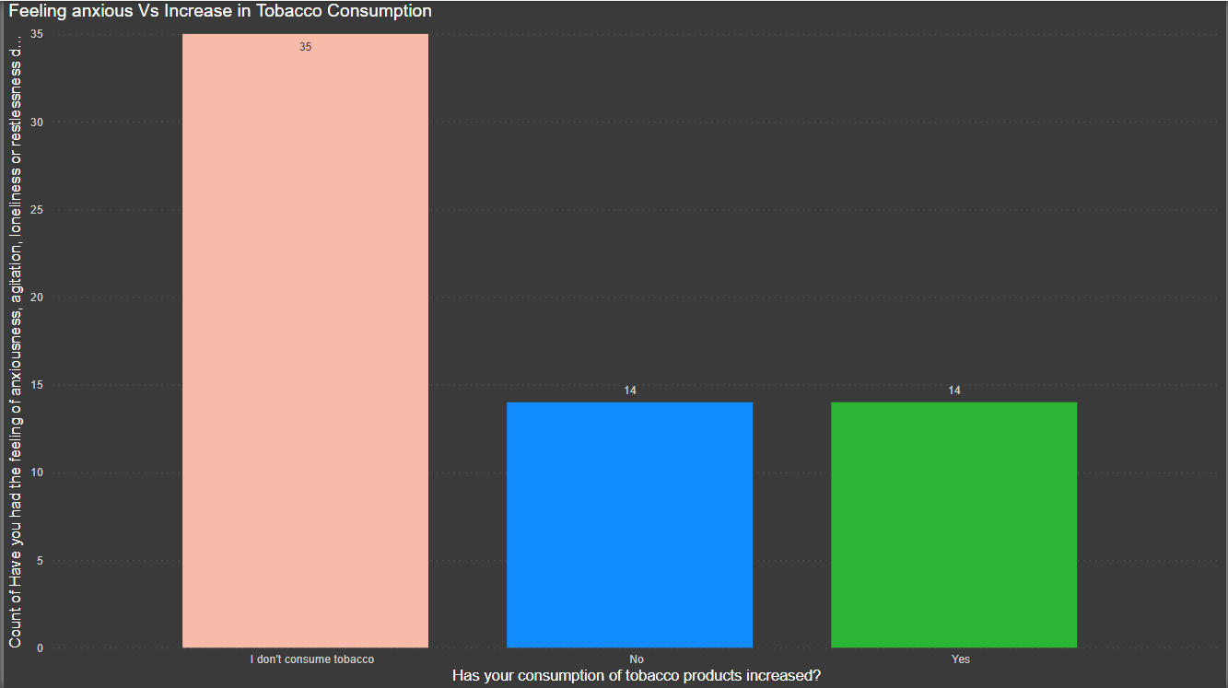
Feeling anxious vs change in tobacco consumption
50% of the total tobacco consumer which is 28 people out of 63 has increased their intake.

Slide 17
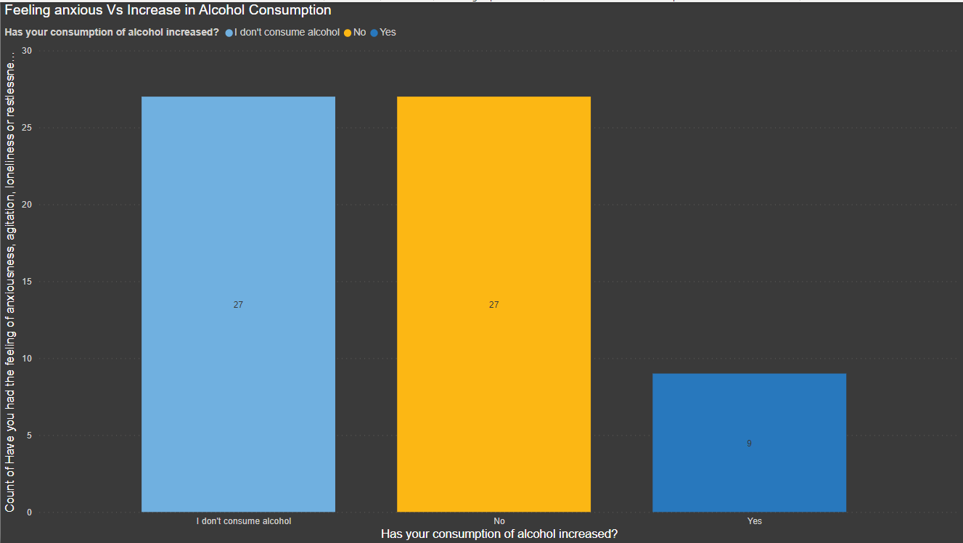
Feeling anxious vs change in Alcohol consumption
25% of the total alcohol consumer which is 36 people out of 63 has increased their intake.

Slide 18
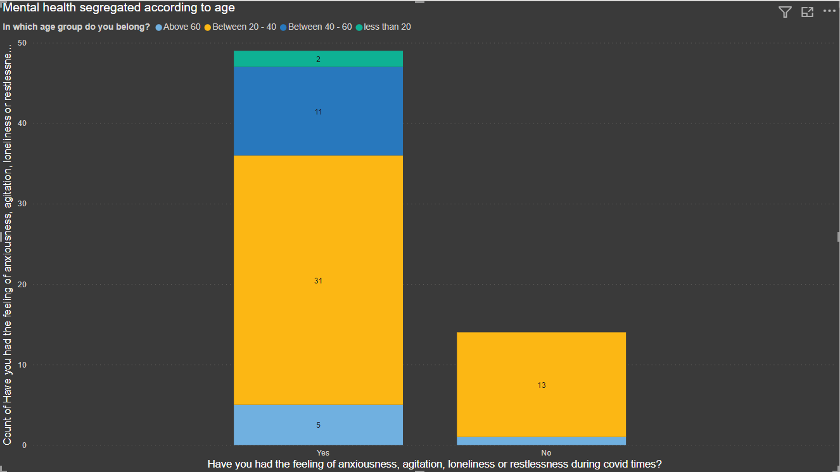
Feeling of anxiousness, agitation vs age of the respondents
74.6% of the total respondents were feeling mentally unwell during this covid times

Slide 19
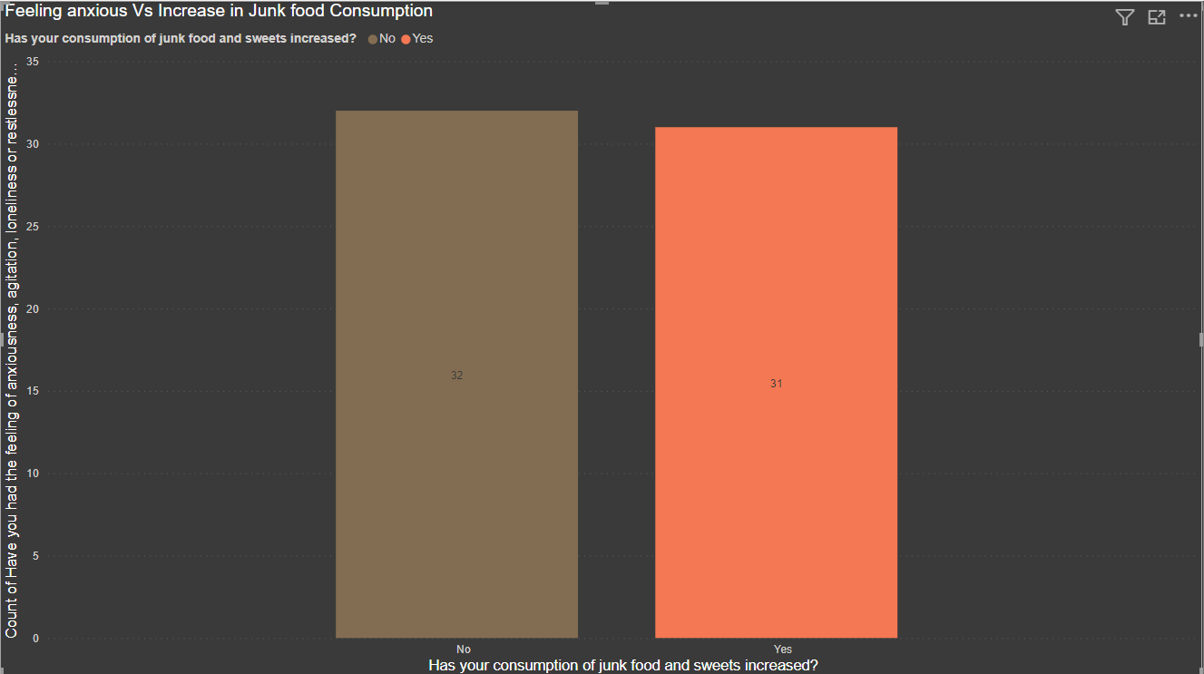
Feeling anxious vs Change in Junk Food Consumption
49.2% of the total sample population has increased their consumption of their junk and sweets food.

Slide 20

Exploratory Data Analysis
In statistics, exploratory data analysis is an approach to analysing data sets to summarize their main characteristics, often with visual methods. A statistical model can be used or not, but primarily EDA is for seeing what the data can tell us beyond the formal modelling or hypothesis testing task.
Based on the results of EDA, companies also make business decisions, which can have repercussions later.
If EDA is not done properly then it can hamper the further steps in the machine learning model building process.
If done well, it may improve the efficacy of everything we do next.

Slide 21
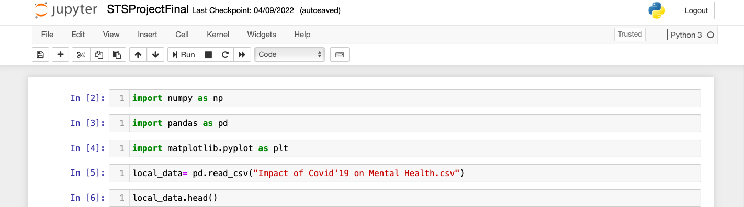
Steps to perform EDA
We are using Jupyter Notebook for analysis and for visualization we are using Tableau. First, let’s import the necessary libraries and store the data in our system for analysis.

Slide 22
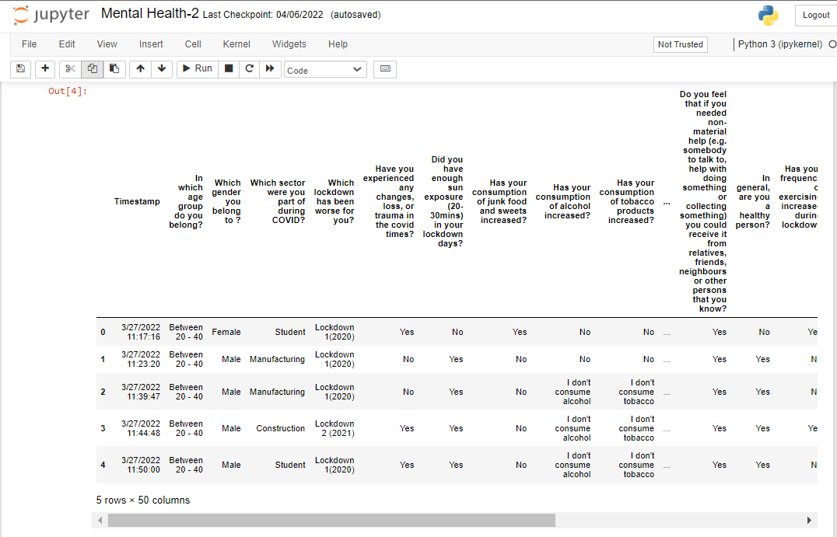
Now, the data set looks like this,

Slide 23
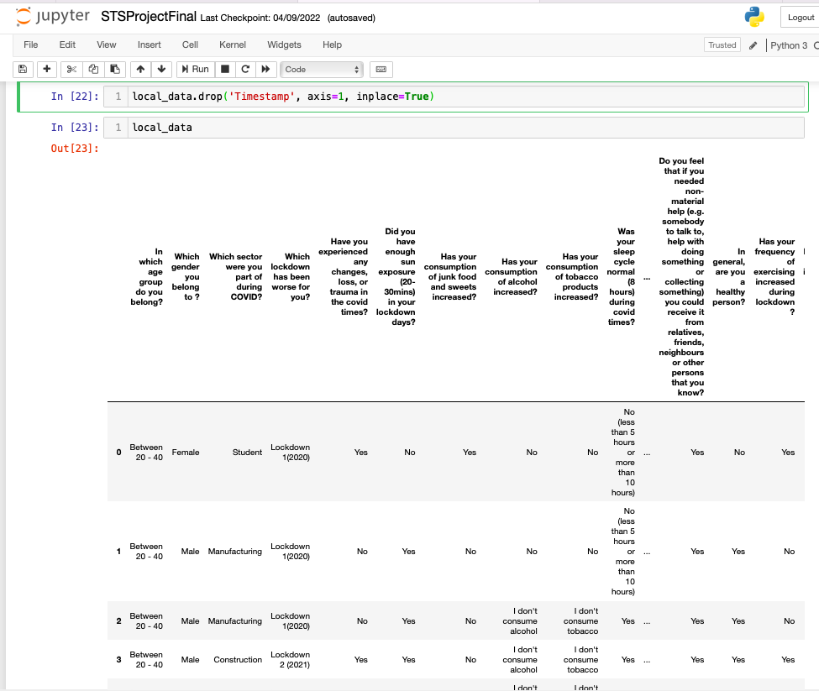
Fixing Column
Fixing Column : If we observe the above dataset, the Time stamp column has not much importance for our analysis . The correct data is from the column 1. So, we have to fix the first column. Let’s drop the column and load the data again.

Slide 24
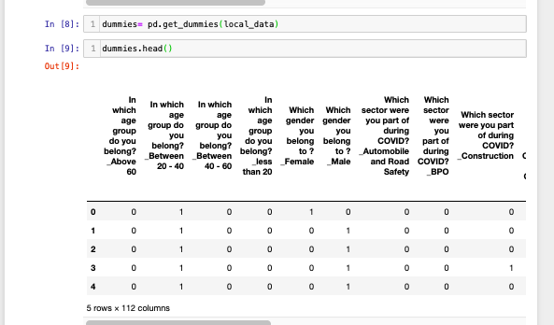
One-Hot Encoding
Since our data is categorical, so instead of ‘Yes’ and ‘No’ we will convert them into ‘1’ and ‘0’, by doing that we’ll get the numerical values. For Conversion the categorical variable , we have used one hot encoding.

Slide 25

Treating the missing values
If there are missing values in the Dataset before doing any statistical analysis, we need to handle those missing values.
There are mainly three types of missing values.
MCAR(Missing completely at random): These values do not depend on any other features.
MAR(Missing at random): These values may be dependent on some other features.
MNAR(Missing not at random): These missing values have some reason for why they are missing.

Slide 26
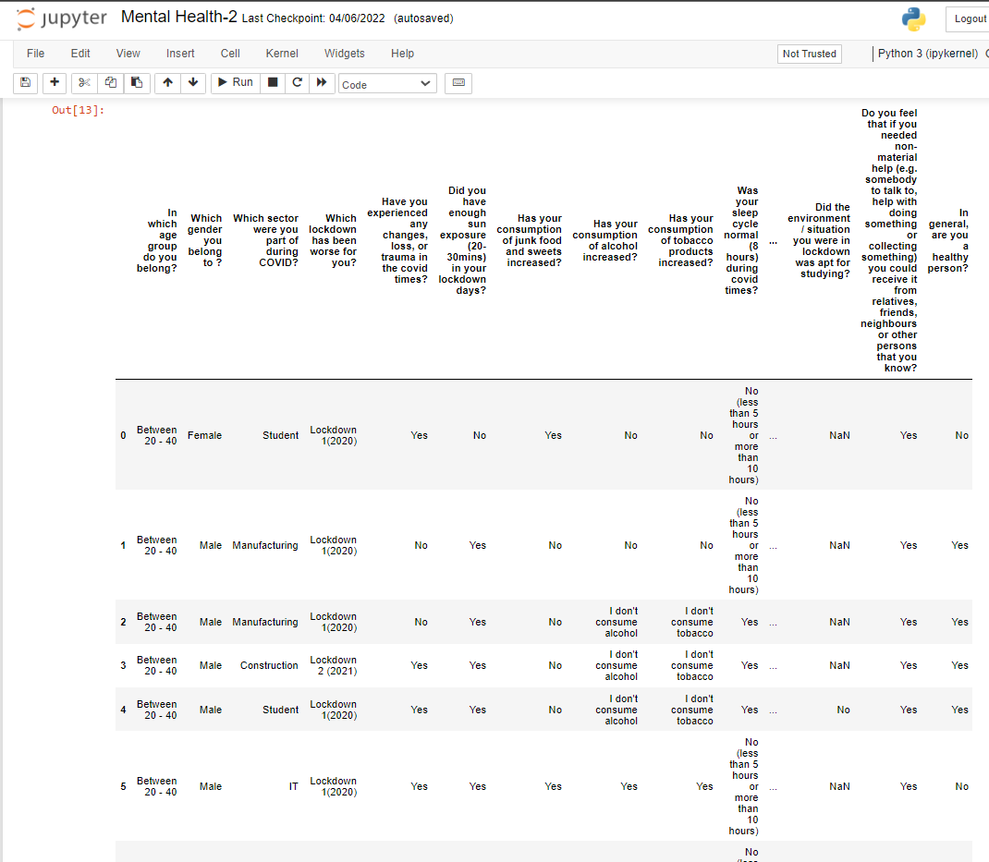
The Missing values of our data

Slide 27
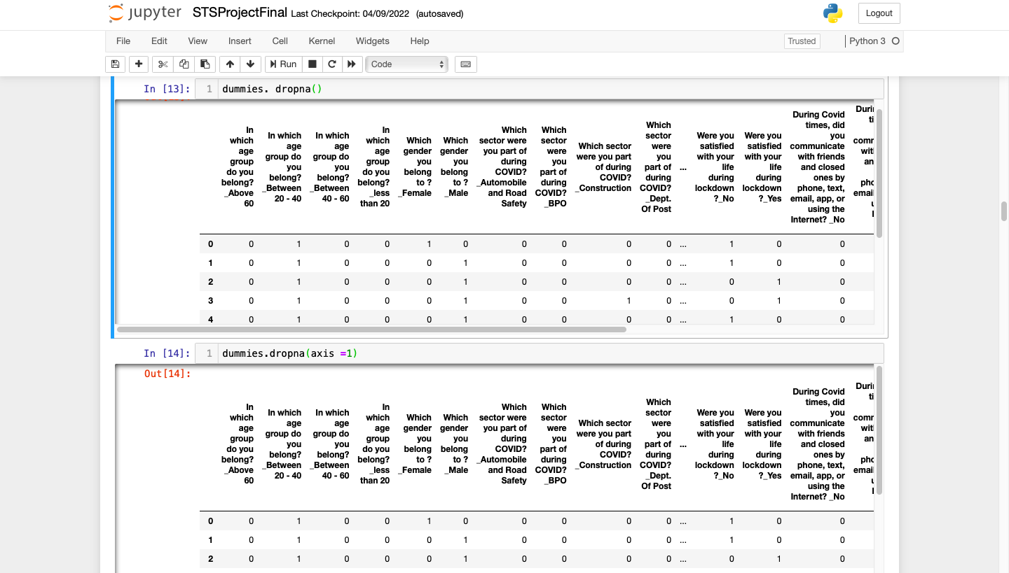
Removal of missing values
We have dropped the null values from both column and row axis by using dropna method from Python.

Slide 28
Bivariate Analysis
Pearson’s correlation coefficient is represented by the Greek letter rho (ρ) for the population parameter and r for a sample statistic. This correlation coefficient is a single number that measures both the strength and direction of the linear relationship between two continuous variables. Values can range from -1 to +1.
Pandas dataframe.corr() is used to find the pairwise correlation of all columns in the data frame. Any NA/ null values are automatically excluded. For any non-numeric data type columns in the data frame is ignored. The default method is Pearson’s method of correlation.

Slide 29
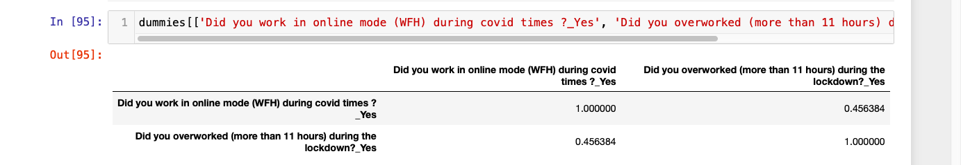
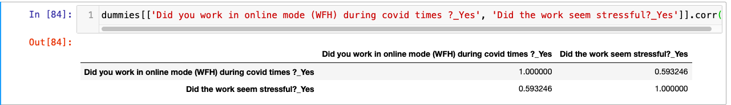
Bivariate Analysis of the online employees and their Stressors
The people working in online mode, weren’t able to distinguish the thin line between office hours and home. The work life balance has been therefore compromised.
The correlation between the online people and overworking during covid is moderate and positive association.
The correlation between people working in online mode and the work being stressful is positive and moderate association.

Slide 30
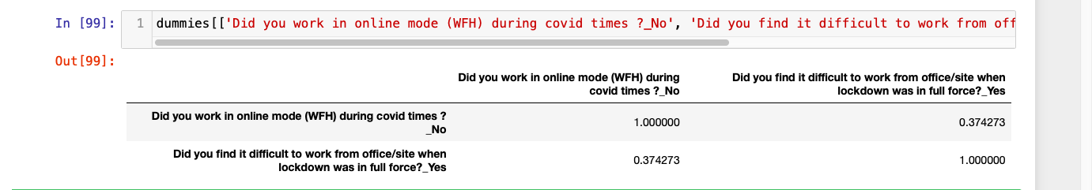
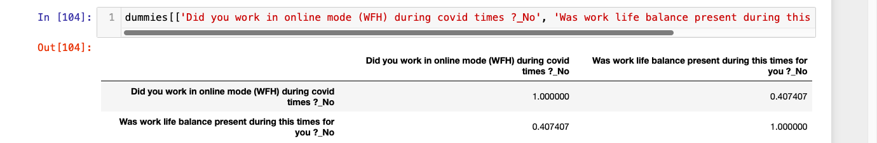
Bivariate Analysis of the offline employees and their Stressors
While some had the privilege of working from home, some didn’t.
The correlation between people working in offline mode and finding difficulty while working in lockdown is positive and moderate assosciation.
The correlation between people working in offline and not having work life balance is positive and moderate association.

Slide 31
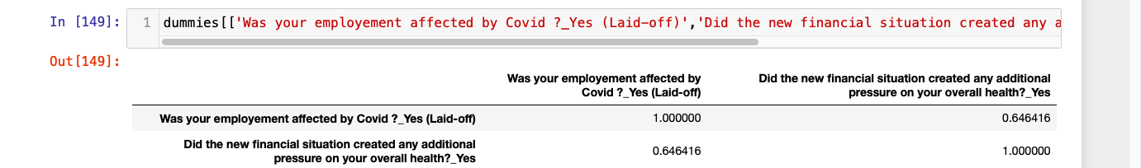
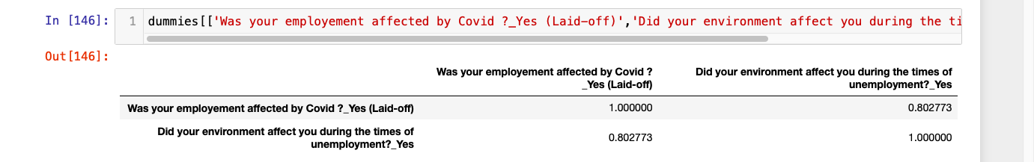
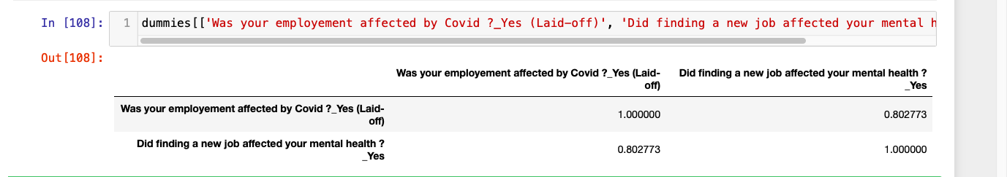
Bivariate Analysis of the laid off individuals and their Stressors
The correlation between being laid off and stress related to financial situation is strong and positive association.
The people who were been laid off during covid, not only felt the stress due to the virus but had to go through a phase of self doubt as well. Here, it shows a strong and positive association between being laid off and having an unpleasant environment during unemployment.
The correlation between being laid off and finding a new job is positive and strong association. This is a no brainer. The stress of finding a new job amid covid where the hiring was in halt, was an add on to the chaos the virus has created.

Slide 32
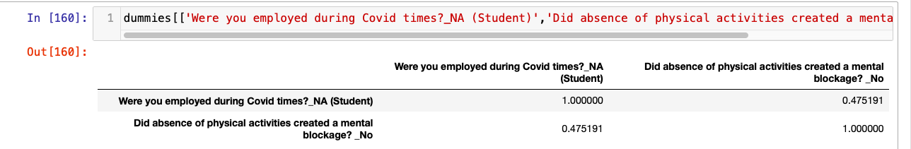
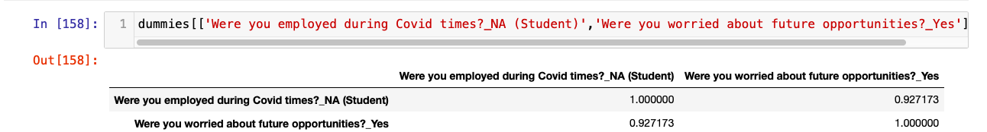
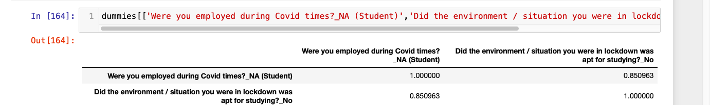
Bivariate Analysis of the offline mode of work and their Stressors
The correlation between students and mental blockage due to inactivity is moderate and positive association. This shows how daily movement is crucial for everybody specially for students who are at a stage where they need an overall development both physically and mentally.
For students, the foundation is the development that happens over School/College. Due to covid, the one thing which got hampered a lot is the quality education.
The correlation between students and the stress related to future opportunities has a positive and strong association.
Students found it very difficult to study during covid times. Therefore, the correlation between students and not having the ideal environment to study is positive and strong association.

Slide 33
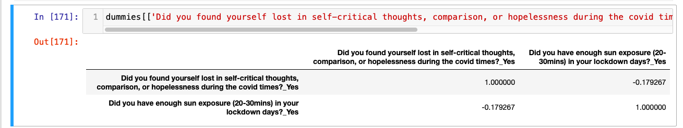
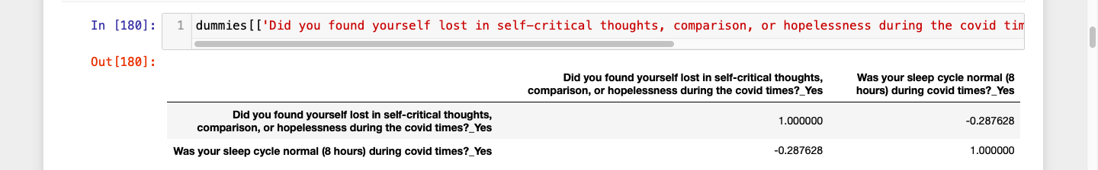
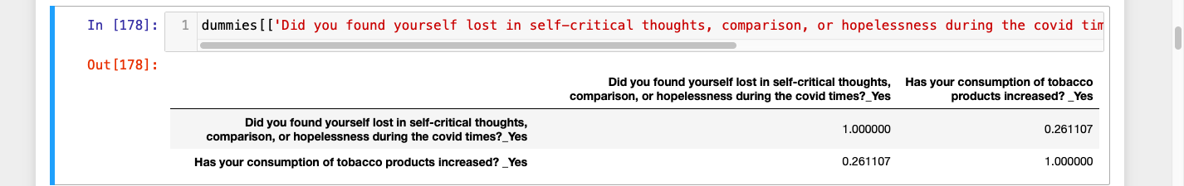
Bivariate Analysis of the depressing thoughts and general habits
The correlation between having self-critical thoughts , hopelessness, comparison and sun exposure is weak and negative correlation. We can infer it from here that how important sunlight is for enhancing our mood. Due to being confined in the four walls during covid made exposure to sun less and hence affected the mood.
The correlation between having self-critical thoughts, hopelessness, comparison and having a normal sleep cycle is weak and negative association. The increase in depressing thoughts make us sleep less and hence affect our sleep cycle.
The correlation between having self-critical thoughts, hopelessness, comparison and increase in tobacco consumption has a positive and weak association. However, during covid the availability of cigarettes was an issue, and therefore the magnitude of correlation has a factor due to which it might got affected.

Slide 34
Conclusion
In conclusion, the current study provides a snapshot of the acute phase impact of COVID-19 on the mental health of the participants. The findings are concerning, suggesting markedly elevated rates of depression and anxiety, among individuals . This worsening of mental health may also have been exacerbated by the severe loss of job opportunities, personal loss. Overall, the findings suggest that interventions to counteract the social, financial and role disruptions induced by COVID-19.
The main focus of our study was on the 4 groups: online employees, offline employees, laid off employees and students.
We found the online employees to be burdened with extended office hours and stressful job life. Whereas the offline employees not only had no work life balance but also were made to work amongst the pandemic rise with life risk. The laid off employees had extra stress of finding a new job, managing their finances whilst the pandemic chaos. Student had to compromise on their student life while bearing the exam stress with an uncertainty of their future career. According to our research, it has been found there has been changes in the general habits of the people such as increase in tobacco, alcohol consumption, junk food consumption and less sun exposure and physical activities.

Slide 35
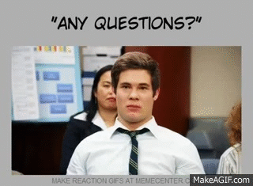
Thank You !!!!

